Slide 1

Job Description & Candidates Profile Matching System
By Zhiyu Zhang
Aug 19th, 2022

Slide 2
Agenda:
Overview and Project Goal
Workflow of Constructing System
What I Have Learned
Reference

Slide 3
Overview and Project Goal
Matching system is one of the most popular artificial intelligence systems for companies in different industries across the world. As a technical recruitment company, OCBang Inc. also wants to introduce this kind of system to fill the gap and improve the experience of clients. We aim to construct a bidirectional matching system between recruiter and potential candidates with machine learning techniques (especially advanced NLP techniques), improving the efficiency of recruitment activity and grabbing market share of our start-up.

Slide 4
Workflow of Constructing System:
Identifying important features in JD and Candidate Profile through recruiting process
Core algorithms for matching system
- Profile Cleaning
- Projecting and Vectorizing
Comparing Similarities
3. Things to be done next

Slide 5
1. Identifying Important Features 1.1 Important Features - Job Description 1.2 Important Features - Candidate Profile

Slide 6
1.1 Important Features – Job Description:
Company | Static Features | Basic Information of Recruiting Company | Industry, Size, Preference (Global/ Domestic, Experienced/ Entry Level), Culture, Review (Rating) etc.
 | Dynamic Features | Specific Requirement for Specific Position | Location, Education (Major/ GPA), Required Skills, Past Experience, Salary, Nationality, Travel etc. (Easy to Vectorize) Responsibilities, Preferred Experienced etc. (Hard to Vectorize – Using NLP)
 | Behavioral Features | Related Activities in Recruiting Process | Searching Preference, Past Recruiting Candidates, Recently Recruiting Candidates & Positions etc.

Slide 7
1.2 Important Features – Candidate Profile:
Candidates | Static Features | Background Information of Candidate | Skills, Educational Background (Major/ GPA), Experience Level (Entry/ Experienced), Hobbies, Location, Nationality etc.
 | Dynamic Features | Past Working and Project Experiences | Working/ Project Experience, Thesis/ Patent, Soft Skills (Leadership, Group Working etc.), Position, Review/ Recommendation from Past Co-workers, Avg Working Length etc. (Try to get key words, replace with synonyms and Vectorize)
 | Behavioral Features | Related Activities in Seeking Process | Searching Preference, Recently Posting Industry & Positions, Intentionality etc.

Slide 8
2. Core Algorithms for Matching System 2.1 Overview 2.2 Profile Cleaning 2.3 Projecting and Vectorizing 2.4 Comparing Similarities

Slide 9
2.1 Overview:
Original
JD/ Resume
Parse Into a Cleaned Dictionary
Vectorize Each JD/CV with a Pre-made Matrix
Store Vectorized Information into Database
Calculate Cosine Similarities of JD&CV and Rank
Get Top Candidates and Recommend
The logic of this matching system is straightforward. We first filter out all useless words (including stop words and punctuations) in the resume and store all cleaned information into a dictionary. Next, Named Identity Recognition can be used to extract all key words, which represent the skillset of candidates. Then, we project those key words to the pre-defined matrix and transfer each job description or resume to one vector. Finally, cosine similarities between JD and profiles are calculated and all candidates with high score are selected and recommended to the recruiter.

Slide 10
2.2.1 Profile Cleaning – Job Description
Before vectorizing, we need to parse each JD and candidate profile to a relative cleaned format. For job description, I choose four-hierarchy system to store the information.
This system relies on one-to-many relationship in data structure. We can store multiple companies, multiple positions, multiple IDs (same position posted in different years may have different ID) and detailed information represented by 9 different aspects.
This structure can be used for different purposes and the example can be found in the next slide.
Position
Location
Position
ID 1
Position
Name 1
Company Name 1
Recruiter
Type
Seniority
Work
Limitation
Company_info
Degree&
YOE
Position
Name 2
Position
ID 2
Responsibilities
Company Name 2
Position
ID n
Qualification
Position
Name …
Company Name …
Recruit
History

Slide 11
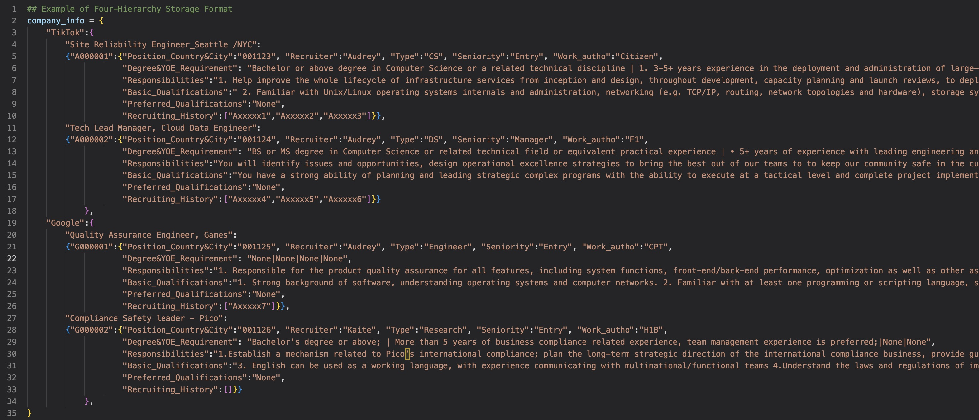
Code Examples of Four-Hierarchy System

Slide 12
2.2.2 Profile Cleaning – Candidate Profile
Name
Before vectorizing, we need to parse each JD and candidate profile to a relative cleaned format. For candidate profile, I choose two-hierarchy system to store the information.
This system relies on one-to-many relationship in data structure. We can store multiple candidate IDs (unique identifier of each potential candidate) and detailed information represented by 9 different aspects.
This structure can be used for different purposes and the example can be found in the next slide.
Location
Candidate ID 1
Work Limitation
Degree& Major
YOE&
Industry
CandidateInfo
Skills
Working Exp
Candidate ID 2
Project
Exp
Candidate ID …
Posting
History

Slide 13
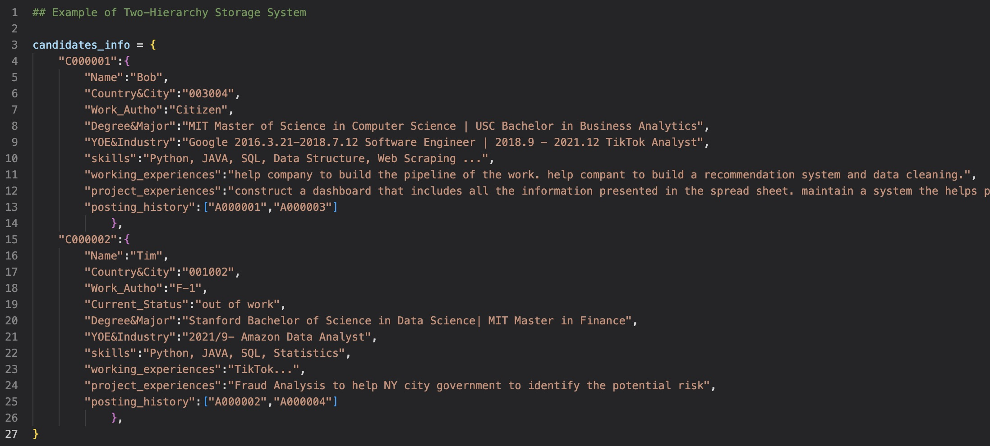
Code Examples of Two-Hierarchy System

Slide 14
2.3.1 Projecting and Vectorizing Workflow
Purpose: Transfer text information to numeric information and fit algorithm easily.
Basic Workflow:
History CV
New CV
Vec
CV
Vec
CV
CV1
Similar
CV5
With recruiting history
Position
(History)
CV2
CV6
CV3
CV7
Company
CV4
CV8
Vec
Pos
Vec
CV
Position
(New)
Similar
CV5
CV6
Without recruiting history
CV7
CV8
New CV

Slide 15
2.3.2 Create Recruiting Matrix and Projecting Key Words
Build a large tech recruiting matrix that contains all aspects of key words.
CV,POS\KEYWORDS | Edu Level | Location | Python | ML | Finance | Leadership | Working Experience | Learning Attitude | Activities | …
cv1 | Master | SF,CA | Prof | Basic Know | A little | Manager | >5 | Learn to xx | Search xxx | …
cv2 | Master | HOU,TX | Prof | x | Prof | Team Leader | 3 | Follow the instruction | Randomly Pick | …
position | > 4-year Bachelor | Flexible | Prof | Basic Apply | X | Manager | >3 | Willing to learn | Data | …
Static Features
Dynamic Features
Behavioral Features

Slide 16
2.3.3 Vectorizing – type1
Features that are Easy to Identify and Quantify:
- Features: Education Background/ Location/ GPA etc.
- Solutions: Directly Transfer Different Categories to Different Numbers.
- Example:
- Potential Questions: # of Categories.
Original
Text
High School
Vectorizing
Result
1
Bachelor
Master
Ph.D.
Post-Doc
2
3
4
5

Slide 17
2.3.4 Vectorizing – type2
Features that are Easy to Make Classification but have Multiple Ways to Express:
- Features: Hard skills.
- Solutions: Cluster all same or similar features and only mark core skills of clustering in the recruiting matrix.
- Example:
- Potential Questions: Hard to include all child skills in pre-defined matrix.
Related
Features
Python
Core
Features
PyCharm
Jupyter Notebook
Django
Python IDE
… (all related words)
Python

Slide 18
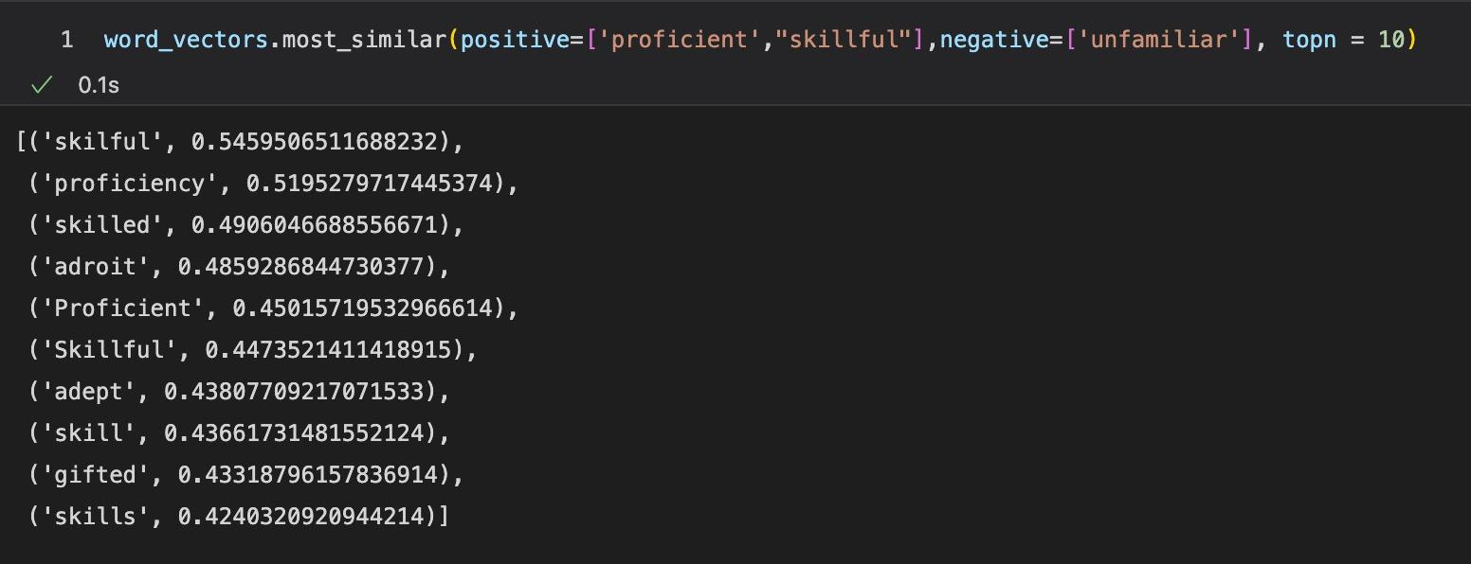
2.3.5 Vectorizing – type3
Features that Have Multiple Ways to Describe:
- Features: Soft skills.
- Solutions: Cluster all similar features and only mark core skills of clustering in the recruiting matrix.
- Example:
- Potential Questions: Word2Vec or BERT needs a relatively large language source to do training.

Slide 19
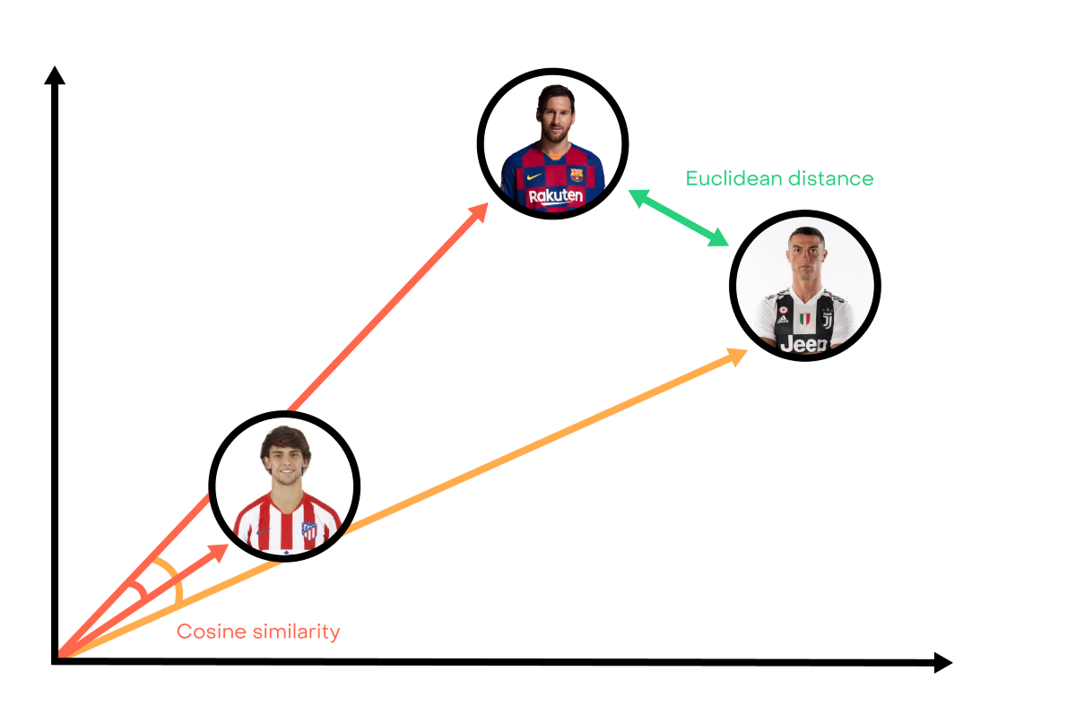
2.4 Comparing Similarities?
Potential Methods: Cosine Similarities OR Euclidean Distance
Final Choice: Cosine Similarities (suitable for high-dimension)

Slide 20
3. Things to be done next

Slide 21
If all elements play the equally important role in decision making?
(Allowing Recruiter to choose weight OR using default weight?)
- Most Difficult Part - Will affect the accuracy directly
2) Should those skills occurred repetitively in Resume or JD be given a higher weight in recruiting matrix?
3) If consider “OVERQUALIFIED” problems?
4) How to cluster the skills as comprehensive as possible to improve the accuracy? (eg. Resume: PyCharm MATCHING JD: Python)
…

Slide 22
What I have learned:
This project is the most comprehensive project I have done with data science skills. On the one hand, it allows me to apply what I have learned in the classroom, including data pipeline, machine learning and database management, to real life. On the other hand, it drives me to learn multiple cutting-edge techniques such as BERT and BiLSTM NN in NLP etc.
Besides those technical skills, I learned how to effectively communicate and collaborate with my colleagues. This experience also helps me to know more about US cultures, improve my soft skills and specify the career goals, which are extremely important for me to find a full-time job here in the next year!

Slide 23
Reference:
SOVREN API FOR MATCHING:
https://www.sovren.com/technical-specs/latest/rest-api/ai-matching/querying-api/search/
SpaCy for NLP:
https://alwaysbelearning.nl/matching-resumes-with-job-offers-using-spacy-a-natural-language-processing-nlp-library-in-python/
https://github.com/microsoft/SkillsExtractorCognitiveSearch/blob/master/data/skill_patterns.jsonl

Slide 24
Thank You!

